Slide 1

JOB REVIEW 2018
& 2019 PLAN
< ASSY group 2019 >
Name: Nguyen Thi Thao
In charge of (this year)
Assy physical inventory
Kitting production PDC2
Div 2 application develop
Tien Son, 25-Jan-2019

Slide 2
Contents
Overview
Review 2018
Plan 2019
Detail systems
Camera checking
Media Label Printing
Physical Inventory
IFC Grease
PM Maintenance Control
PA control
TSS & Production Auto machine
Control in-out Sub pregnant

Slide 3
REVIEW ASSY SYSTEM 2018

Slide 4
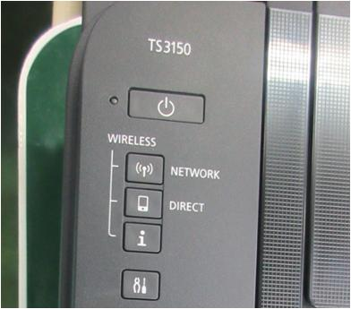
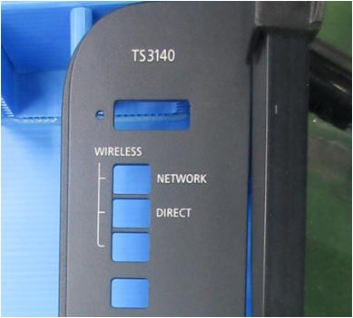
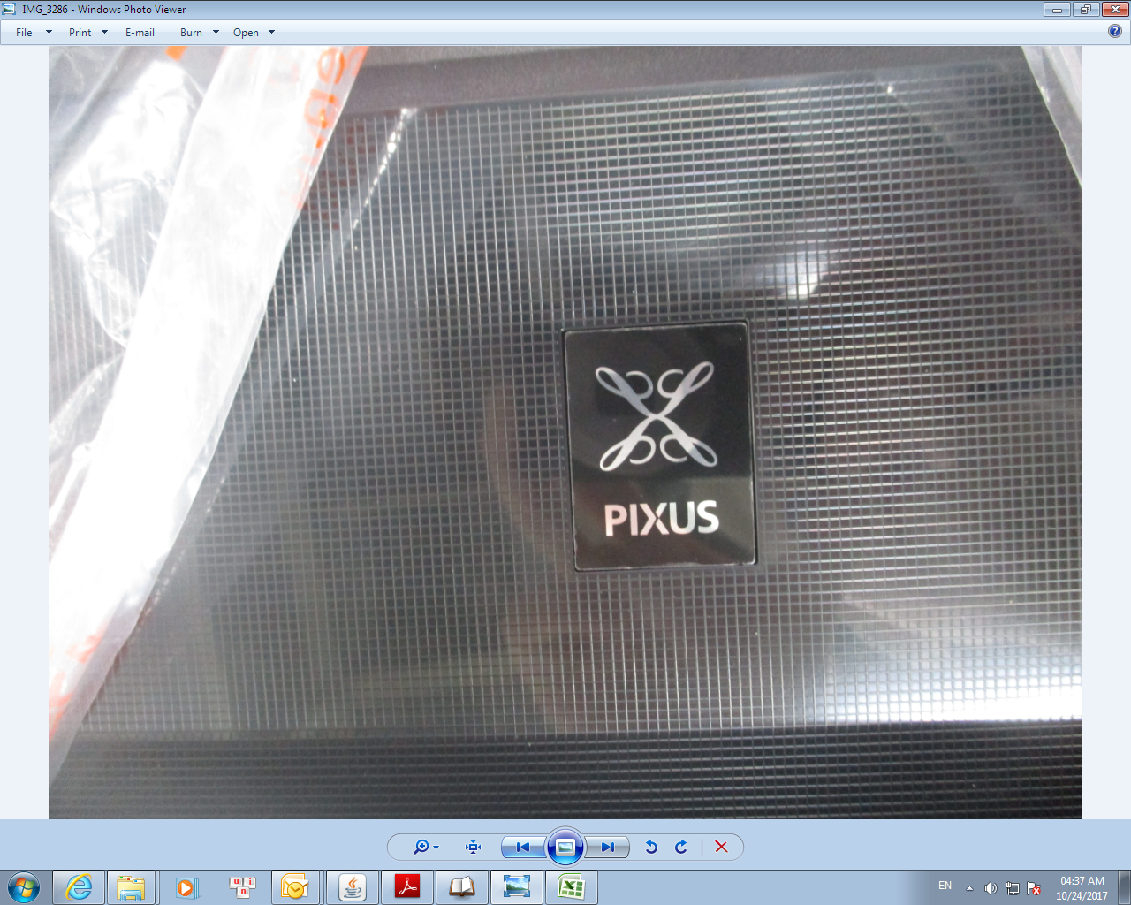
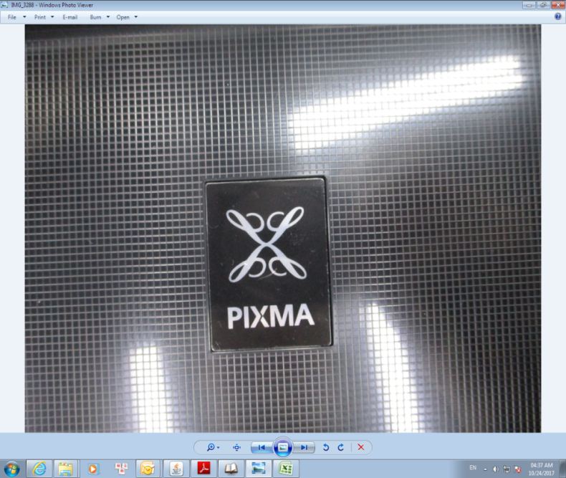
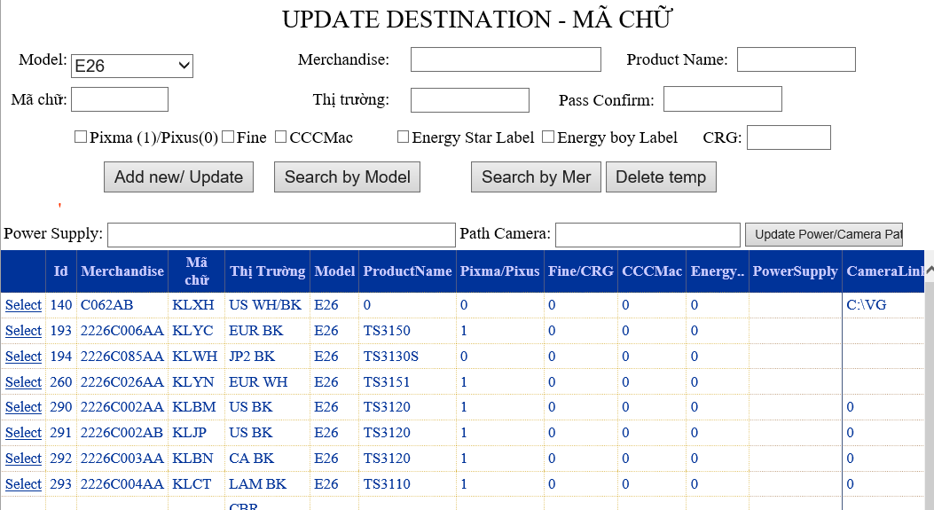
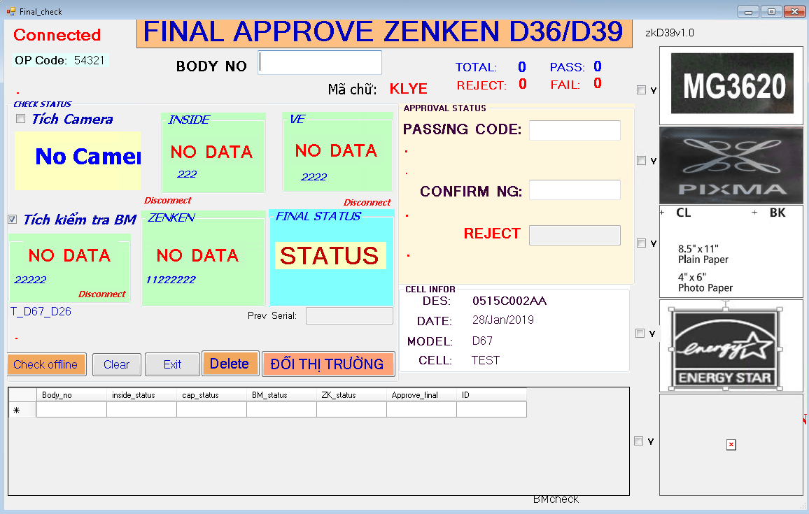
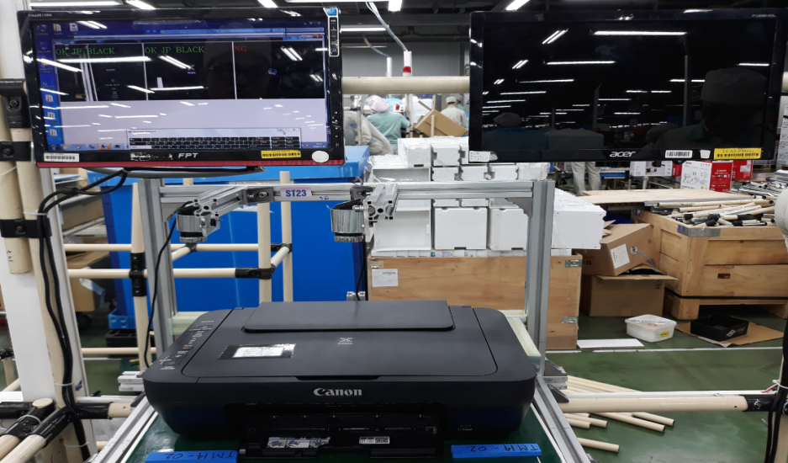
CAMERA CHECKING
BEFORE
Manual check OP Top
Example:
PROBLEM : E26 WRONG OP TOP COVER FROM GB TO MEA
OK : TS3140 (MEA)
NG : TS3150 (GB )
➔ What: Wrong Top cover JP ➔CN des
➔ When: Q4.06.Dec.2017
➔ Where: TS17-01A (E21)
➔ Who: QAZK
JP
CN
NG
OK
NG Part
OK Part
Using part wrong des : OP top , Access cover, Top cover , Emblem…
Missing label follow des : Fine , CRG label , CCC mark label , Guide product year label ….
AFTER
Camera check OP Top
QC update master check by Destination
Funtion Camera check at Zenken
Check & return value to Zenken
QAZK monitor
Apply all model
Change 77 yellow point to green point
NEXT PLAN
Continue expand for new model

Slide 5
MEDIA LABEL PRINTING
I ➔BACK GROUND
II ➔IMPROVEMENT
3- IFC of label in 2018
Step1
Apply IT system for In tem printing label (Auto link plan & data accuracy)
Control in- out child part in system
Step3
Apply using camera check FA (Prevent mistake)
Step2
Month | Mục | Type | Qty | cost | Total cost
Jan | Wrong Mer destination CN Ver01 | Wrong | 279 mc | $ 0.35 | $ 98.40
 | Print wrong des | Wrong | 1448 pcs | $0.0051 | $7.37
Feb | Print repeat number | Repeat | 748 pcs | $0.0051 | $ 3.81
May | Print wrong des | Wrong | 1800 pcs | $0.0051 | $9.16
Aug | Using old version of Merchandise code | Wrong | 500 mc |  | $37.84
Aug | Wrong pin code number on War | Wrong | 1296 mc | $ 0.477 | $619.40
1.Ruduce muda time Operation
➔Katsu-jin 1 OP
2. prevent mistake by Human
Recheck/ rework
20.34$
755.6$
Defect part

Slide 6
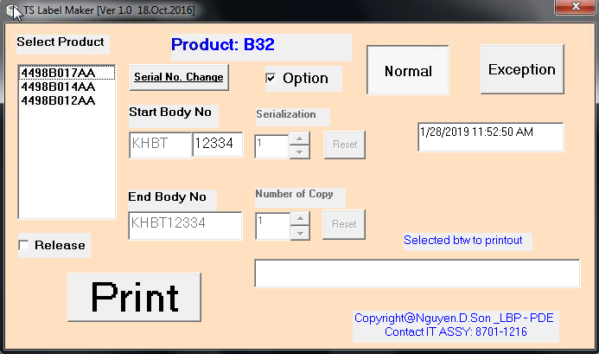
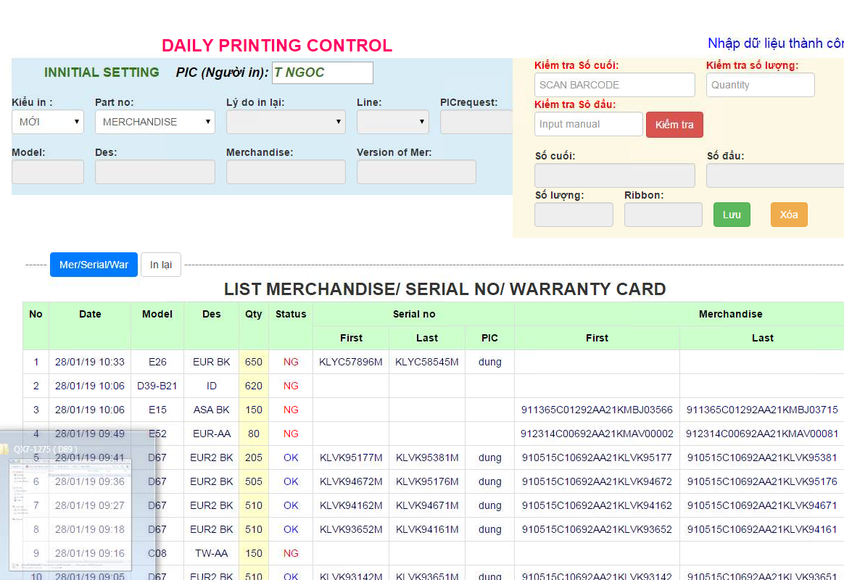
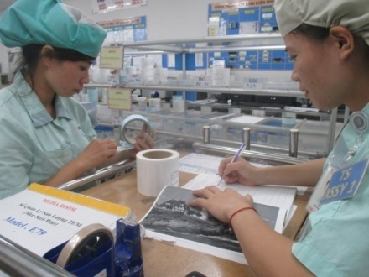


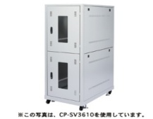

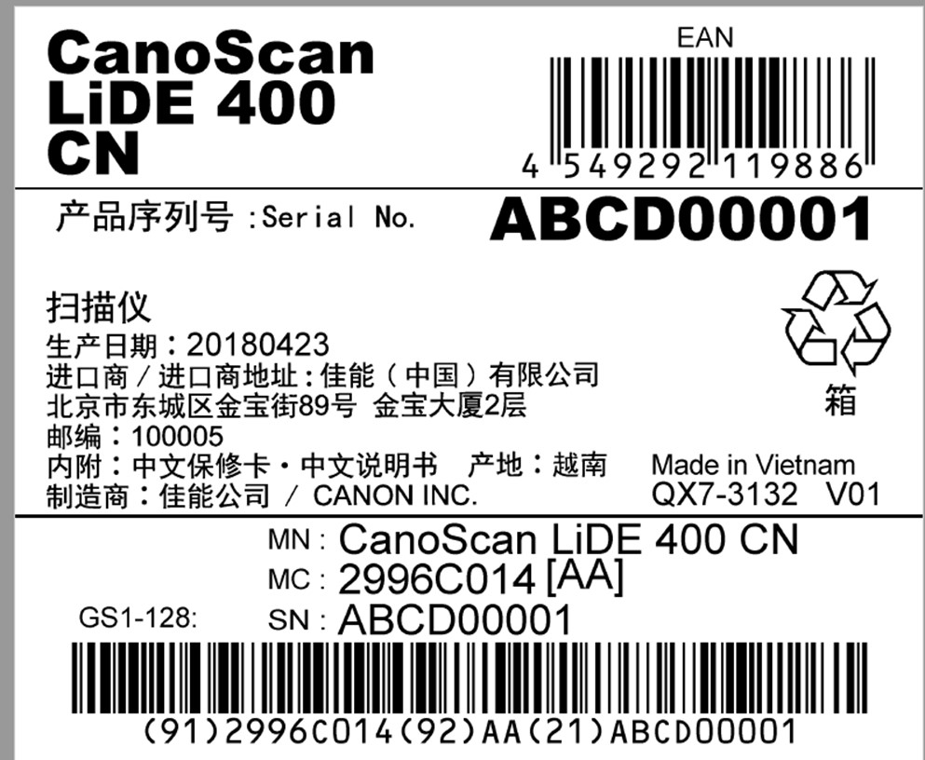
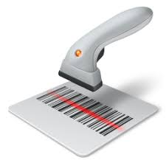
MEDIA LABEL PRINTING
BEFORE
Canon dat program:
AFTER
Step1
Modify Website label printing from TL
Avoid duplicate label
Not keep history printing
Control supply to cell by paper
Manual check FA -> easy mistake
Avoid duplicate label
Keep history printing
Control supply to cell by paper
Manual check FA -> easy mistake
NEXT PLAN
Step2
Step3
system
Control supply to cell on system
Camera check FA -> prevent mistake

Slide 7





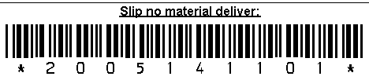




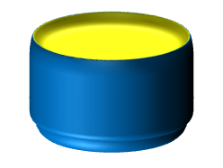
PHYSICAL INVENTORY SYSTEM
Purpose
Auto control stock
CLD control part on cell by system
Reduce time control
DSS system
Hoan Kiem system
Lending part system
PDC System
High accuracy Inventory part.
Reduce time control
How to do?
Step 1:
Cut PI book
Reduce time control
Step 2: High accuracy inventory part:
Link DSS, HK, Lending part, PDC
Control supply by barcode
Step 1
Line 3
Line 3
PI System
Step 2
Line 3
Line 3
Line 3
Borrow - return
2h*2
Repair area
Main line
Office
Kiting
Kiting
Counter area
Kiting
Kiting
Kiting
Kitting area
SILK -SUB
PDC
Store ASSY

Slide 8
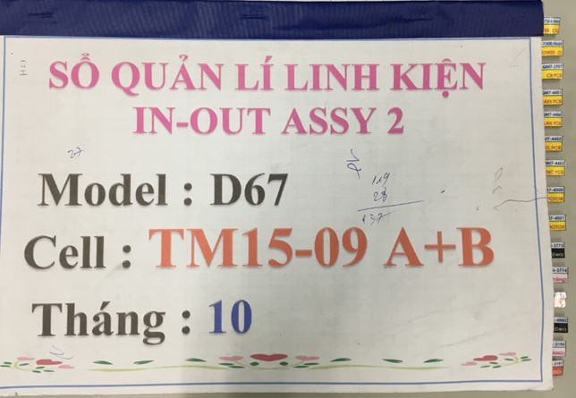
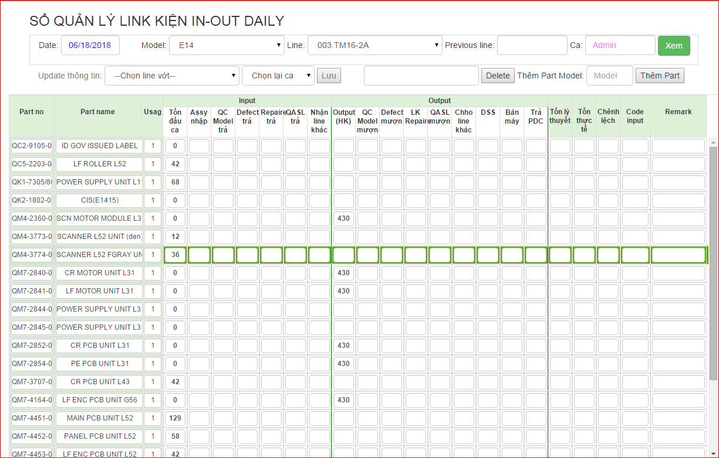
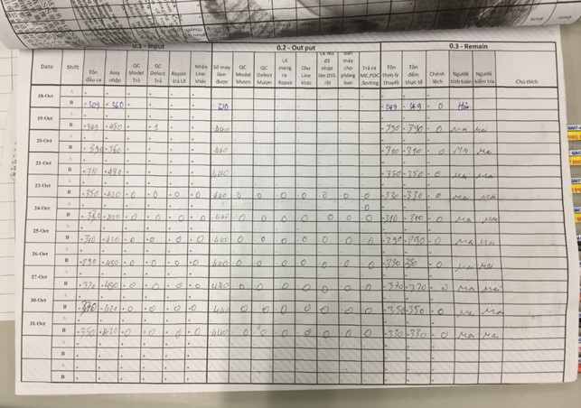
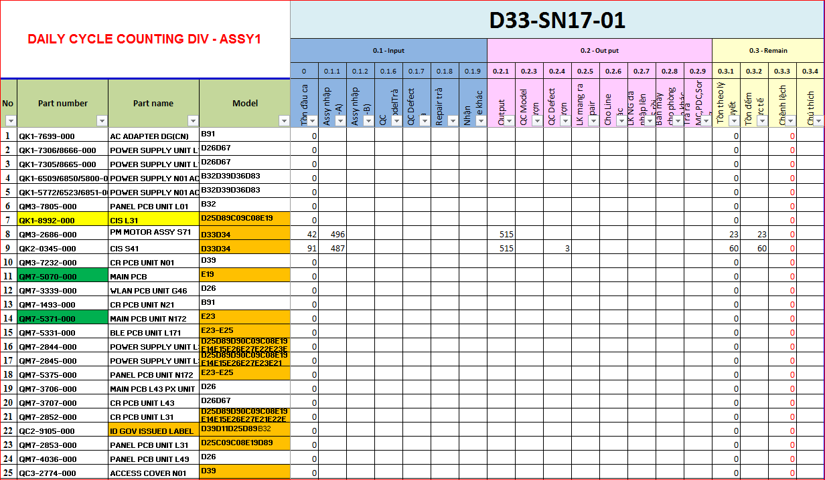
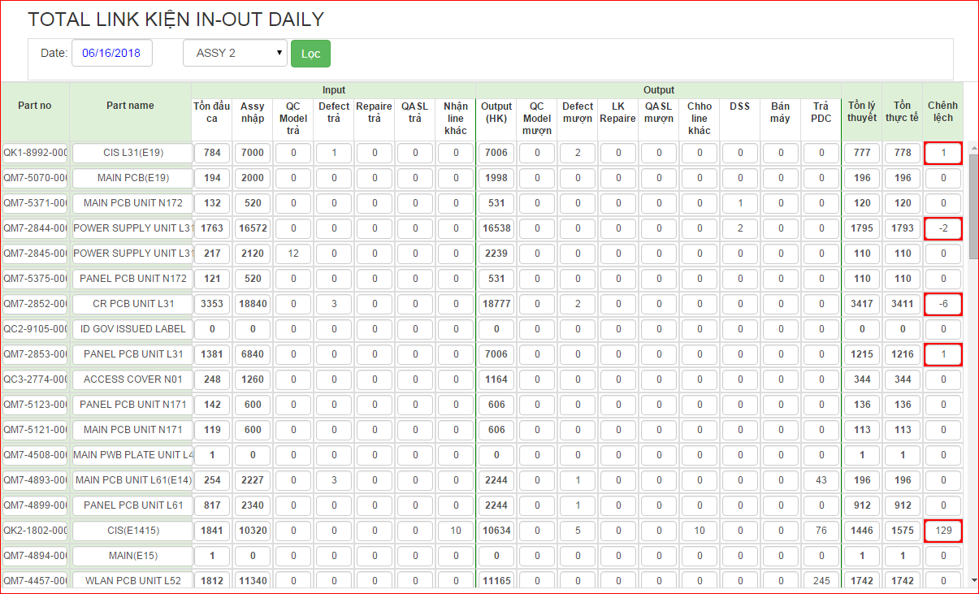
PHYSICAL INVENTORY SYSTEM
Before:
CLD/SP input to PI book
After: step 1
CLD/SP input to PI System
Apply from Apr.2018
Counting by manual
(Daily counting)
Manual input data to excel
Auto Summarize data by Dept
Take manpower to input to excel & summarize data daily (2h/dept/OP)
No job inputting to excel & summarize data daily
⇨ reduce 2h/OP/day * 2 dept
Reduce 5760 min/month

Slide 9
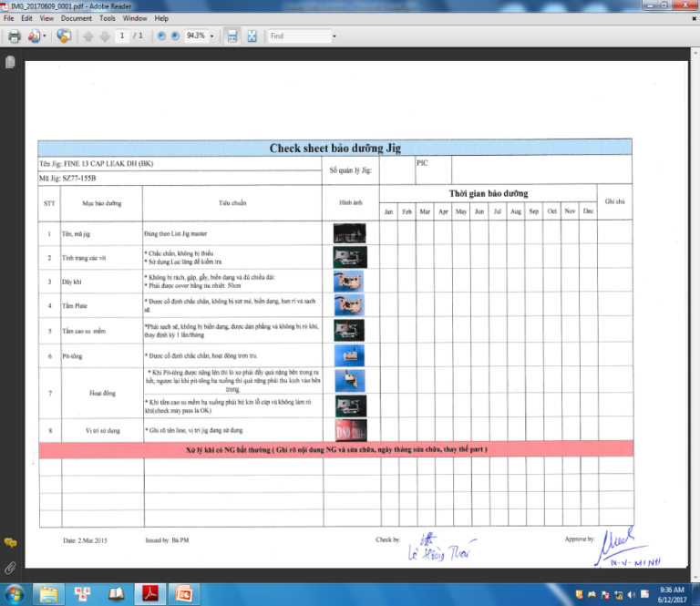
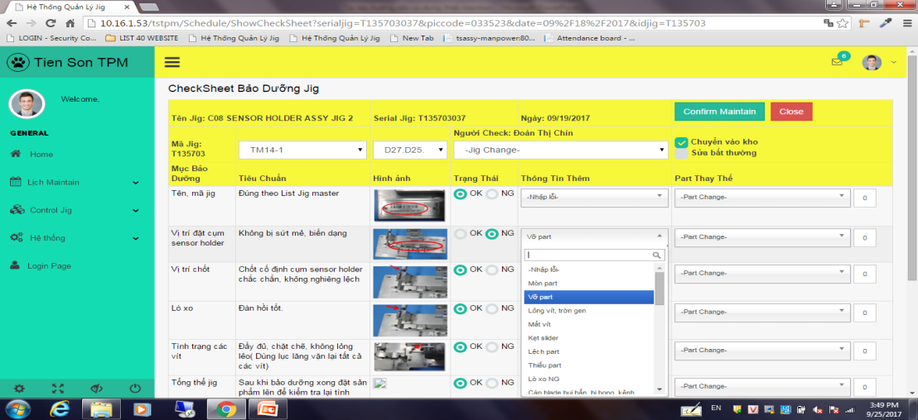
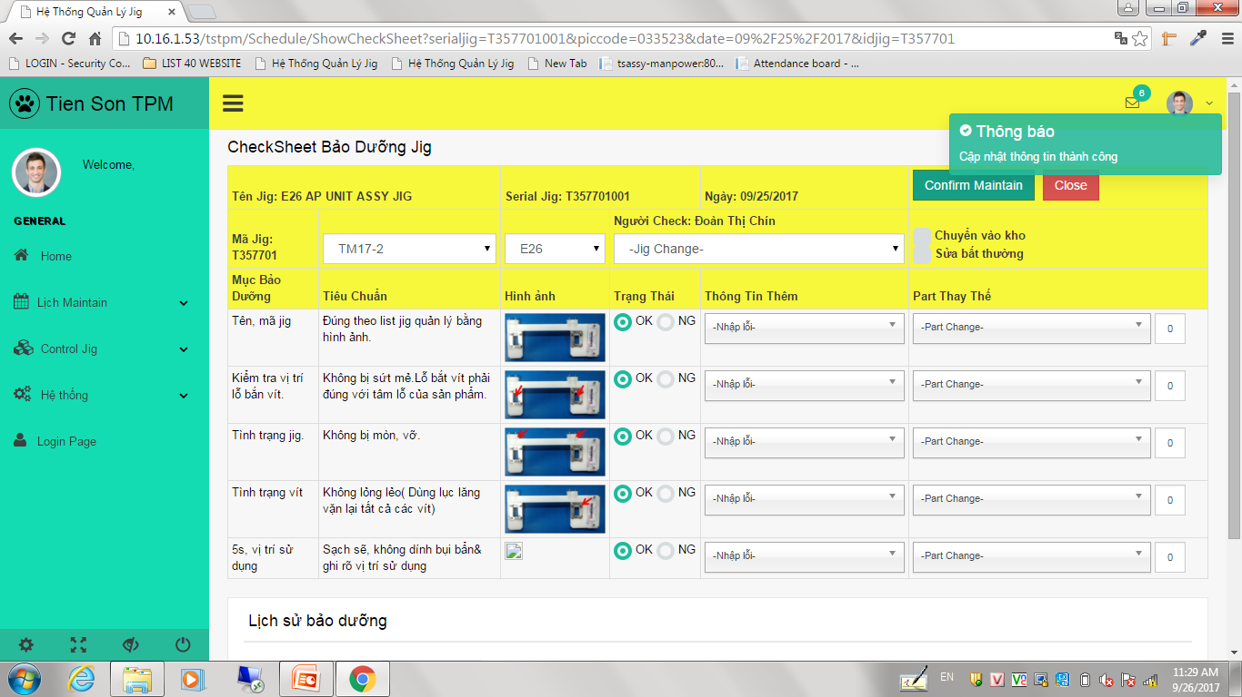
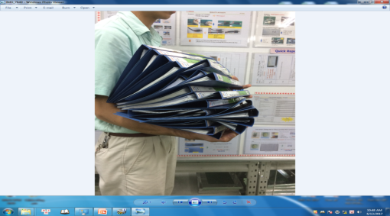
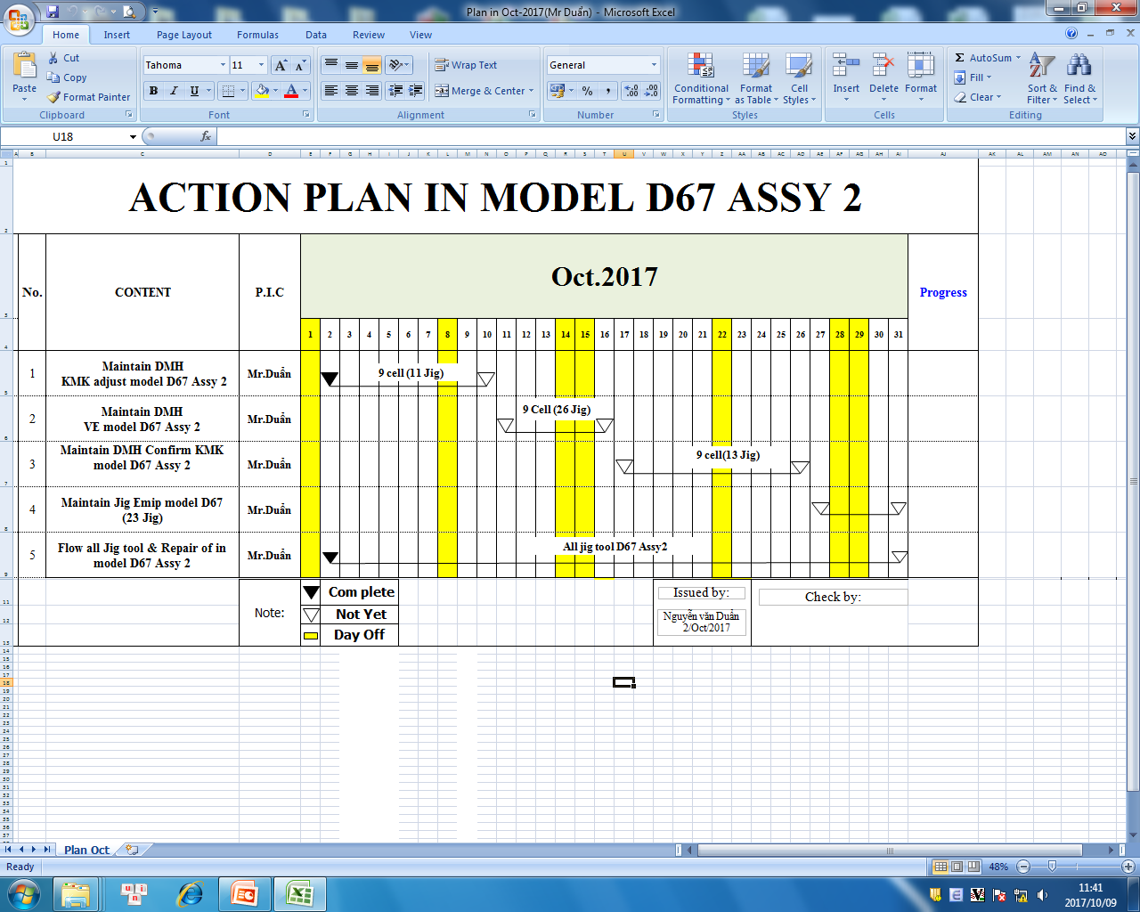
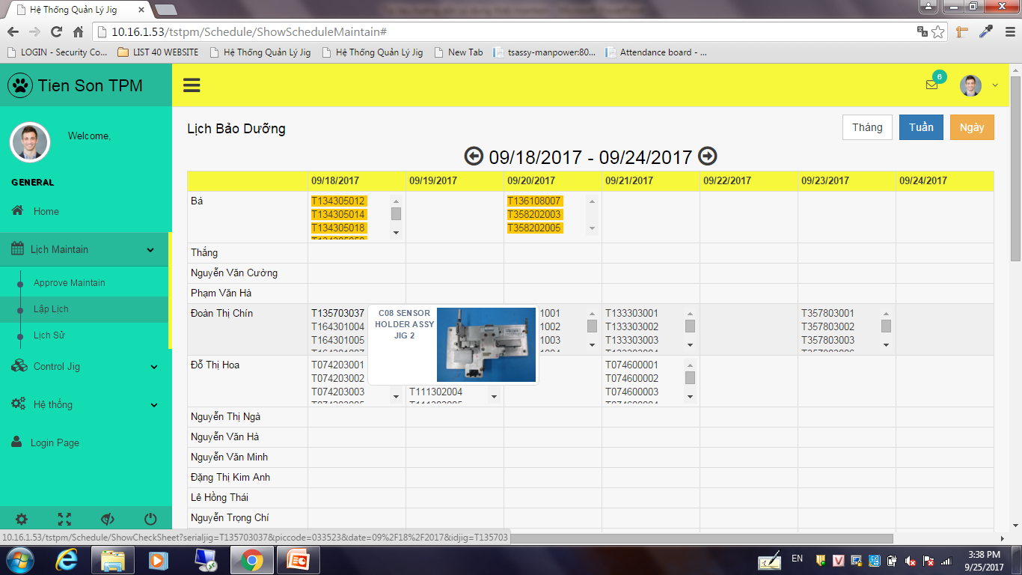
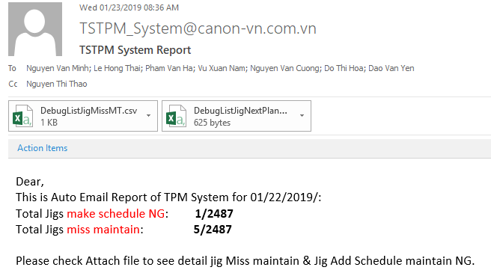
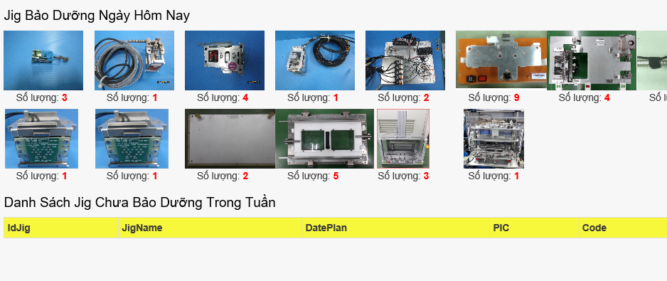
PM MAINTENANCE SYSTEM
With make check sheet
Before: Using paper sheet for maintain
After: Using Web for maintain
PM member must to print 7100 check sheet&make book with 3800 min
Need store save checksheet after maintain
PM member only update for 330 checksheet on Web➔ Reduce 20kg paper & 3500min
No need store save checksheet (all result save on IT system)
With make plan maintain
PM member make plan maintain monthly(30min)
Visualize schedule maintain of jig all day( monthly)
Control maintenance
Take time to check paper sheet => difficult control
Auto warning on website & email => easy control
Visulize on Andon system: cell by cell

Slide 10
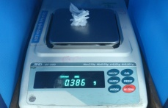
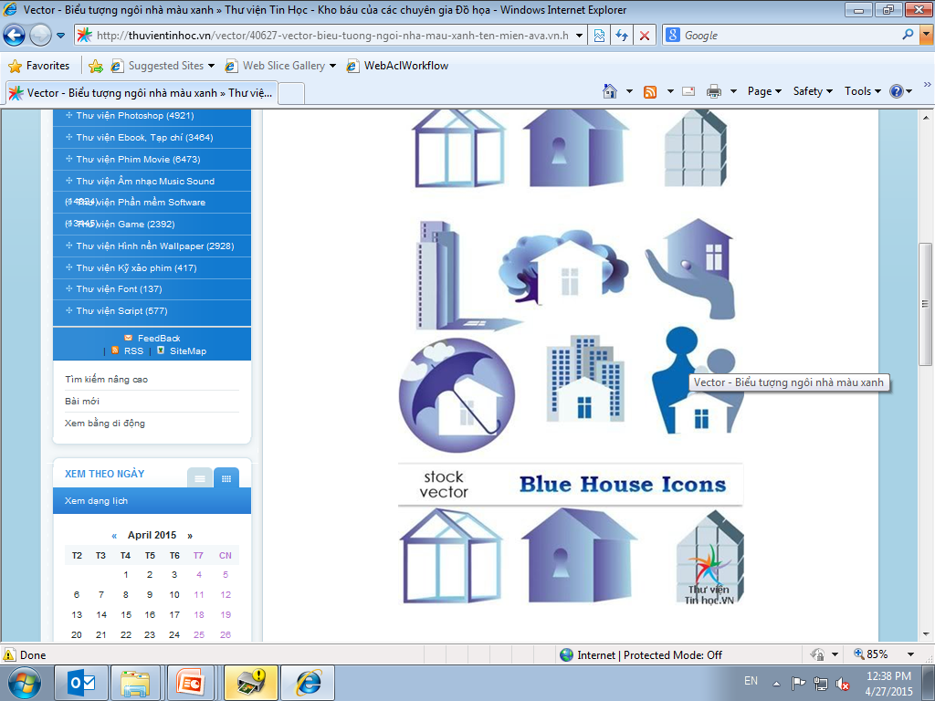



QAFC GREASE
BEFORE
By manual
Accuracy low
Data not exactly
Difficult Check history
Get data
Manual record
Save data
AFTER
By IT System
Get data
Timely data
Exactly data
Easy Check history
Visualize value
Auto Send
Auto record
Wi-Fi
Analyze
NEXT PLAN
Analyze data
Quality up
Tighten check
Untighten check
Grease check

Slide 11
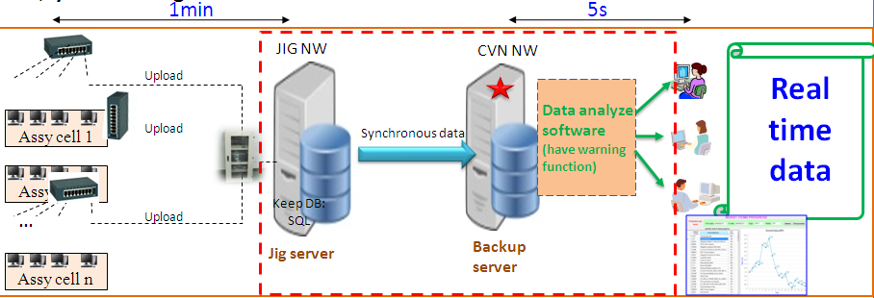
KAIZEN SYSTEMS
BEFORE
Upload checker data slowly (40s) -> decrease effect of ZK & Packing ST
Do not auto upgrade version -> take time setting
Offline program NG -> can not apply when Jig net work NG
AFTER
Upload checker data slowly (20s)
Auto upgrade version
Apply OK Offline program
NEXT PLAN
Upload checker data immediately (change timer method to watcher)

Slide 12
PLAN ASSY SYSTEM 2019
SYSTEMS
PURPOSE
TARGET
STATUS
PIC
I. System develop new 2019
1. Media label printing System
- Control history print lable
- Control supply, cut in-out book
- Prevent NG label to cell
- Apply camera check label
0%
Thao
2. Physical Inventory System
- Reduce workload & Cut PI book
- Cut book control in-out & exactly data
0%
- Exactly data & visualize index
for sub preg, auto machine & PCB part
Thao, Song
3. Kitting Production PDC2
- Count actual production timely
Apply for E26,E27
- Prevent wrong part to cell
10%
Thao
4. TSS & Production Auto machine
- Count production Auto machine
- Fastest call PM support
- Auto make plan, reduce workload for CLD
0%
Song
5. Control PA
- Correct data & reduce workload
- Visulize index
- Strickly control in-out
0%
Song
6. Training System
- Record history training
- Take test on System
- Apply from IT training system for ASSY
0%
Song, Thao
II.
Fllow & kaizen Old System
- Add OP scan card on cell
7. Cellmanagement system
- Show & visualize all information by cell:
for attendance system check
0%
Thao
manpower, PI, attendance, ...
- Link to HR System -> cut time upload new
- Reduce workload
man manual
- Quality upcheck ESD
8. ESD System
- Reduce workload CLD update OP card
- Expand funtion repalce scan card on cell
0%
Thao,Song
- Link to Cell management System
- Auto make maintain schedule jig/tool
9. TPM System
- Keep history maintenace
Fllow system
Thao
- warning & remind staff schedule
- Expand & apply for new model:
- No check sheet paper on cell
E52,E53,D83 & F23,F24
10. Check sheet less System
- Reduce workload
- Reduce setup time & reduce operator
0%
Thao
- Correct data & quality up
using system
- Using “watcher” upload data -> Fastest upload
11.QAFC
- Reduce workload & correct data
Fllow system
Thao
- Visualize index
12. LBP System
- Production timely
- Correct production timely
0%
Thao
- Correct data OPR & daily report
- Cut 10' daily SLD upload manual
13. Quality System (winform)
- Visualize & report exactly OPR IJ data
Fllow system
Thao
14. Spare part control (champ)
- Control sparepart on stock
Fllow system
Song
15. Work standard system (webform)
- Control update work standard
Fllow system
Thao
16. Batery control (PHP)
- Control batery & time batery charge
Fllow system
Song

